Slide 1
6 Entities & Relationships
6.1 Preview of the logical structure of the next few chapters

Slide 2
We will look at ...
a simple example to show why single table databases are not always sufficient
  you can’t build houses from straw alone
entities and relationships
  bricks and mortar

Slide 3
... & (Data) Normalisation:
what makes a well-designed table / database
  how to lay out the windows and doors so that the house doesn’t fall down
at this stage (& not really before) we can
  critically assess our database designs
  discuss properly the choice of (Primary) Keys

Slide 4
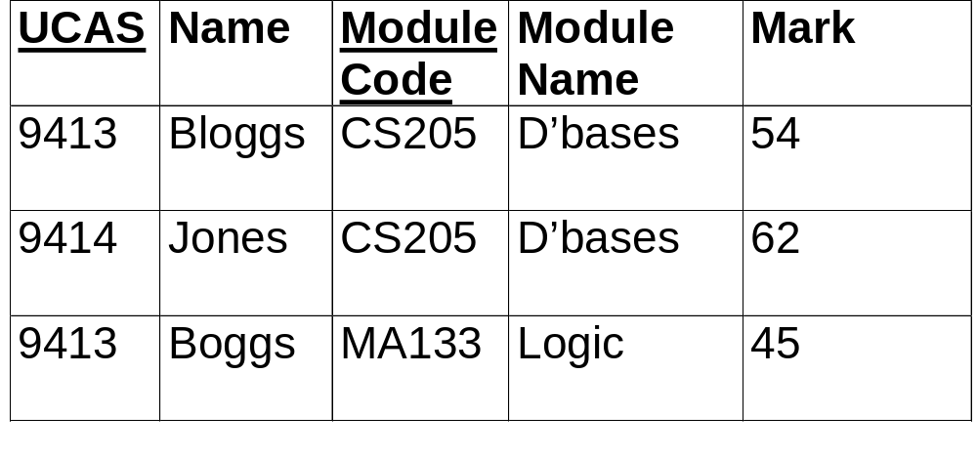
6.2 Example of Redundancies

Slide 5
Lead to anomalies on
updating
deleting
inserting
multi-table database with relationships the solution
some situations too complicated for a single table, anyway

Slide 6
6.3 Abstraction of “Entity"
consider the (European) countries, as in Practical 1
we shall henceforth say that
  any particular country is an instance of the entity COUNTRY
  eg Albania is an instance of COUNTRY, France is an instance of COUNTRY

Slide 7
Entity & instance
COUNTRY ... |  | ... & an instance
entity contains
Name |  | Albania
AreaSqKm |  | 11,099
Population |  | 3,331,000
Capital |  | Tirana
CapitalASeaport |  | No
PopulationOfCapital |  | 239,381

Slide 8
...
for the purposes of our database, what constitutes a COUNTRY is essentially specified by (the format of) the information we must supply to specify an instance
But this is only useful because we have an (abstract) idea of what a country is, and know that Albania and France are both countries

Slide 9
Attributes
Name, AreaSqKm, Population, Capital, CapitalASeaport, PopulationOfCapital are all referred to as attributes of the entity COUNTRY
  we assume all instances of the entity have the same set of attributes
[Kroenke uses Entity Class for the set of all instances of a given type of entity]

Slide 10
Recap (in new terms)
table a collection of records
one record per instance of the entity
  I have previously been rather sloppily saying “one record per entity”
all records are for (different) instances of the same entity
(primary) key - field(s) which uniquely identifies record

Slide 11
6.4 Relationships
entities (objects of interest)
attributes (properties of entities)
relationships between entities
  1-1
  1-many
  many-many
entity-relationship diagrams

Slide 12
1 to 1 – example 1
MP & constituency
MP
1
1
CONSTITUENCY
represents
Name
D.o.b.
Party
Name
Electorate

Slide 13
1 to 1 – example 2
employee & [company] car
1
1
EMPLOYEE
CAR
is assigned to
No
Name
Dept
Reg No
MOT due
cc

Slide 14
We may combine ...
... the two entities in a 1 to 1 relationship into a single entity if the relationship is mandatory in both directions
  eg every employee must have a car, every car must have an employee
if not, combining would result in blanks (null values) in the table
  in such cases, keep separate

Slide 15
1 to many
typical relationship in a database
eg director & films
DIRECTOR
1
N
FILM
directs
Name
D.o.b.
Nationality
Title
Date
Studio

Slide 16
1-many (implementation)
primary key of the 1 side as a field (or fields) in the many side
  where it is known as a foreign key
identifies which record (or entity instance) on 1 side corresponds to the given record (or entity instance) on the many side (which director made this film)
Notes:
When was the director who made “Casablanca” born?
List the titles of films made by directors born post 1945

Slide 17
...
the DBMS (Access) uses this information to support queries etc.
similar implementation for 1 to 1

Slide 18
Notation
in diagrams, I’ll just use “crow’s feet” to indicate a “many” end to a relationship, and an unadorned line to indicate a “1” end
  ie I’ll omit the 1’s and N’s
some people use 1’s and N’s
  perhaps without crow’s feet
some put a diamond on the relationship line:
1:N

Slide 19
Many to many
students and modules
STUDENT
MODULE
takes
UCAS
Name
Degree
...
Code
Title
Co-ordinator
...

Slide 20
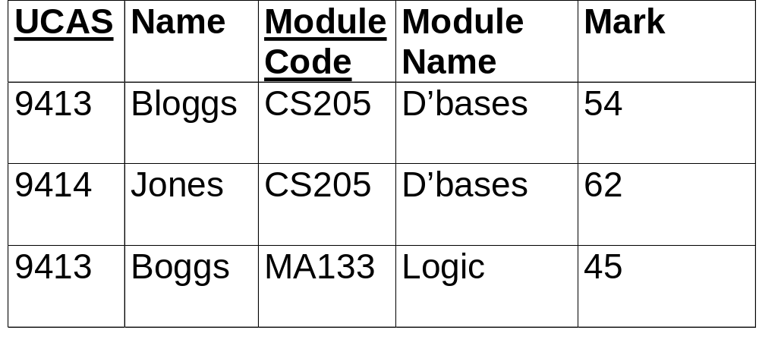
Recall our example

Slide 21
Splitting a Many to Many
introduce a new table to split the many to many relationship into two 1 to many relationships
the primary key of the new table is both the keys of the related tables
  eg UCAS and Code
some attributes naturally belong as fields in this new table eg mark

Slide 22
Many to Many as split
STUDENT
MODULE
UCAS
Name
...
Code
...
REGISTRATION
UCAS
Code
Mark

Slide 23
Well structured tables
if, for example, we put each of a student’s modules into a separate field, then
  the tables wouldn’t have a fixed number of columns (necessary for efficient working)
  the modules wouldn’t be on an equal footing
our method avoids these pitfalls

Slide 24

In a 1 to many relationship..
the table on the one side is called the primary table
the table on the many side is called the related table
the (primary) key of the one side, where it appears as a field in the many side, is called a foreign key

Slide 25
To identify relationship type ...
Ask How many of Y “can go with” a Z? and vice versa eg
  How many MP’s can represent a given constituency? Ans – 1
  How many constituencies can be represented by a given MP? Ans – 1
  so the relationship is “1 to 1”

Slide 26
A neater notation
Writing out the data in tables ...
... has to be done eventually to set up the database
  probably better done in Access
... but is a clumsy way of describing the structure of the tables, so we use a conventional representation

Slide 27
Conventions
ENTITY in capitals
primary key underlined
foreign* key* denoted by asterisks
  Kroenke uses italic for foreign key
other attributes in plain text
examples

Slide 28
Director & Films
DIRECTOR( Name, D.o.b., Nationality)
FILM(Title, Date, Studio, Name*)
  it might perhaps be clearer if we used “DirectorName” instead of “Name”

Slide 29
Students & Modules
STUDENT(Ucas, Name, ...)
MODULE(Code, ...)
REGISTRATION(Ucas*, Code*, Mark)

Slide 30
Employee & Car
assuming
  each car is assigned to one employee
  each employee has at most one car, but may have none
EMPLOYEE(EmployeeNo, Name, Dept)
CAR(RegNo, MOTdue, cc, EmployeeNo*)

Slide 31
MP & Constituency
if we decide to keep separate ...
... we could put the primary key of constituency as a foreign key in MP
... or perhaps vice versa
  efficiency considerations decide
  or do you foresee missing MP’s?
in Employees & Cars I deliberately chose to avoid blanks

Slide 32
6.5 Relationships in Access
Relationships window shows current ones
can add or delete tables
can add relationships (mouse drag key field of 1 side to matching field in many side)
  1 to 1 also possible
  relationship dialog box allows editing of relationship details
can delete relationships

Slide 33
Related fields must match
same Data Type, same Field Size
  &, of course, same entry for related records
Exceptions:
  a Long Integer Number will match an Autonumber
  a Number will match an Autonumber if both have FieldSize Replication ID (rare, only relevant where multiple copies of database kept)

Slide 34
Motivation for exception
Autonumbers sometimes used as primary keys, but requiring a matching Autonumber on the many side is nonsense because
  can’t edit values
  would make the relationship 1 to one

Slide 35
6.6 Referential Integrity
Referential Integrity means that relationships are valid & don’t have unattached records in the related table
  there aren’t any films (in the films table) whose director isn’t listed (in the directors table)
it is recommended as a “validation” check
  e.g. to trap mis-spelt entries

Slide 36
Enforcing Referential Integrity ...
... stops you removing a record (or changing its primary key) in the primary table if there are related records in the related table
  you can’t delete a director if there are some films that s/he made listed
  Cascade Delete Related Records (or Cascade Update Related Fields) relaxes the rules, but changes the related data to preserve integrity

Slide 37
& also stops you ...
.. adding a record in the related table if there is no related record in the primary table
  you can’t add a film made by a director who isn’t listed
null entries are allowed in the foreign key
  you can add a film with DirectorName blank
  if you don’t want this relaxation, set the Required property for the foreign key

